Slide 1
DFT and FFT Algorithms Exploring the Core of Signal Processing
Mohammad Mohammadi – 402208592
School of Mathematics – Sharif University of Technology
Course Instructed by Dr. Zarei

Slide 2
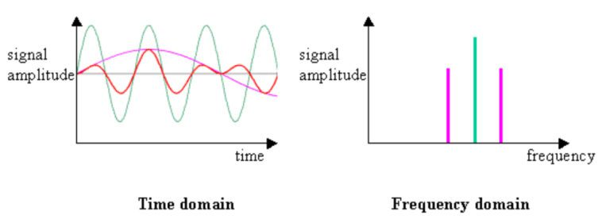
Introduction to Fourier Transforms
Definition and Essence: Fourier Transform is a mathematical technique for decomposing a function (like a signal) into its constituent frequencies, translating it from the time or spatial domain to the frequency domain.
Revealing Frequency Spectrum: It's crucial for revealing how different frequencies contribute to the overall makeup of a signal.
Types of Fourier Transforms: Continuous Fourier Transform (for continuous signals), Discrete Fourier Transform (DFT), and Fast Fourier Transform (FFT).
Signal Processing Importance: Fourier Transform has vital role in signal processing, including applications in data compression, noise reduction, and signal reconstruction.

Slide 3
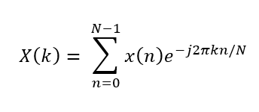
What is DFT?
Definition: Discrete Fourier Transform (DFT) is a mathematical technique used to convert a sequence of values (usually a signal) into components of different frequencies.
Basic Formula: The DFT formula converts a finite sequence of equally-spaced samples into a sequence of complex numbers, representing the amplitude and phase of underlying frequencies.
Key Principle: DFT analyzes the frequency content of a discrete signal by decomposing it into a sum of sinusoids (sine and cosine functions) of different frequencies.
Here, X[k] is the k-th element of the output, x[n] is the n-th element of the input signal, N is the total number of samples, i is the imaginary unit, and e is the base of the natural logarithm.

Slide 4
Principles of DFT
Fundamentals:
Linearity: DFT is linear, meaning the transform of a sum of signals is the sum of their transforms.
Symmetry: DFT exhibits certain symmetrical properties, especially in the way frequency components mirror around the Nyquist frequency.
Periodicity: In DFT, both the input time sequence and the output frequency sequence are treated as periodic. This periodicity is inherent in the DFT's circular nature of mapping between time and frequency domains.
Transform Pair: The DFT and its inverse (IDFT) are known as a transform pair, enabling conversion between time and frequency domains.
Frequency Resolution: DFT provides a frequency resolution that depends on the duration of the signal being analyzed and the sampling rate.
Definition: Frequency resolution refers to the ability of DFT to distinguish between different frequency components in a signal.
Dependence on Sample Length: The frequency resolution is inversely proportional to the length of the time-domain signal being transformed. Longer data sequences provide finer frequency resolution.
Impact of Sampling Rate: The frequency resolution also depends on the sampling rate. A higher sampling rate allows for a broader range of frequencies to be analyzed, but doesn't necessarily improve the resolution of closely spaced frequencies.

Slide 5
Applications of DFT
Digital Signal Processing: DFT's role in analyzing digital signals in various domains is huge, such as telecommunications, radar, and audio engineering.
Spectral Analysis: DFT is used to study the frequency spectrum of signals in fields like astrophysics and seismology. (Seismology is the scientific study of earthquakes and the generation and propagation of elastic waves through the Earth or other planetary bodies)
Image Processing: DFT is applied in image compression and filtering techniques.

Slide 6
Limitations of DFT
Computational Complexity: The computational complexity of DFT (O(N²) operations) makes it less practical for large N (number of samples).
Leakage and Windowing:
Spectral Leakage occurs when the DFT of a signal contains frequency components not present in the original signal, usually due to the finite length of the signal. And it leads to the spreading of energy of a frequency component to adjacent frequencies.
Windowing is a technique to minimize leakage by multiplying the signal with a window function before applying DFT. It shapes the signal so that it reduces discontinuities at the boundaries
Aliasing: Aliasing problem happens due to discrete sampling and its implications.
Happens when a signal is sampled below its Nyquist rate (twice the highest frequency present in a signal), causing higher frequency components to be indistinguishable from lower frequencies.
Results in distortion as higher frequencies "fold back" into the lower frequency spectrum.

Slide 7
Introduction to FFT
Definition: Fast Fourier Transform (FFT) is an algorithm to compute the DFT efficiently, significantly reducing the required computations.
Breakthrough: FFT, developed by Cooley and Tukey, has revolutionary impact on making DFT computations practical for large data sets.
Efficiency: FFT reduces the complexity from O(N²) to O(N log N), making it much faster for computational purposes.
Algorithm Efficiency: While DFT directly computes each frequency component, resulting in O(N2) complexity (for N data points), FFT cleverly reuses the results of smaller DFTs through a divide-and-conquer approach.
Divide and Conquer: FFT breaks the DFT into smaller DFTs recursively, grouping data points and reducing the total number of computations needed.
Radix-2 Decimation: A common FFT algorithm, Radix-2, splits the DFT into two halves - one for even-indexed points and one for odd-indexed points, which are then computed in parallel and combined, significantly reducing the number of operations.
Computational Reduction: This approach changes the complexity to O(NlogN), drastically reducing computation time, especially for large N.

Slide 8
History of FFT
Early Developments: The roots of FFT trace back to algorithms proposed by Gauss in the early 19th century, initially for interpolating the orbits of asteroids using trigonometric series.
Cooley-Tukey Algorithm: The Cooley-Tukey algorithm, introduced in 1965, revolutionized FFT by efficiently computing DFTs for a large number of data points, making it practical for widespread digital signal processing.
Impact on Computing: FFT's rapid computation ability transformed numerous fields, from audio signal processing to radar technology, by enabling fast and efficient analysis of large datasets in real-time.

Slide 9
FFT Algorithms
Types of FFTs: Different FFT algorithms, such as Radix-2 and Radix-4, are designed for specific scenarios; Radix-2 is optimized for data sets with a power-of-two size, while Radix-4 handles larger sets more efficiently.
Decimation-in-Time (DIT) and Decimation-in-Frequency (DIF): DIT FFT algorithms break down the DFT first by even-odd separation of time samples, while DIF algorithms start with frequency decomposition, both leading to efficient computations.
Practical Implementations: FFT algorithms are implemented in various software and hardware systems, with optimizations for specific applications like real-time audio processing or large-scale data analysis in scientific research.

Slide 10
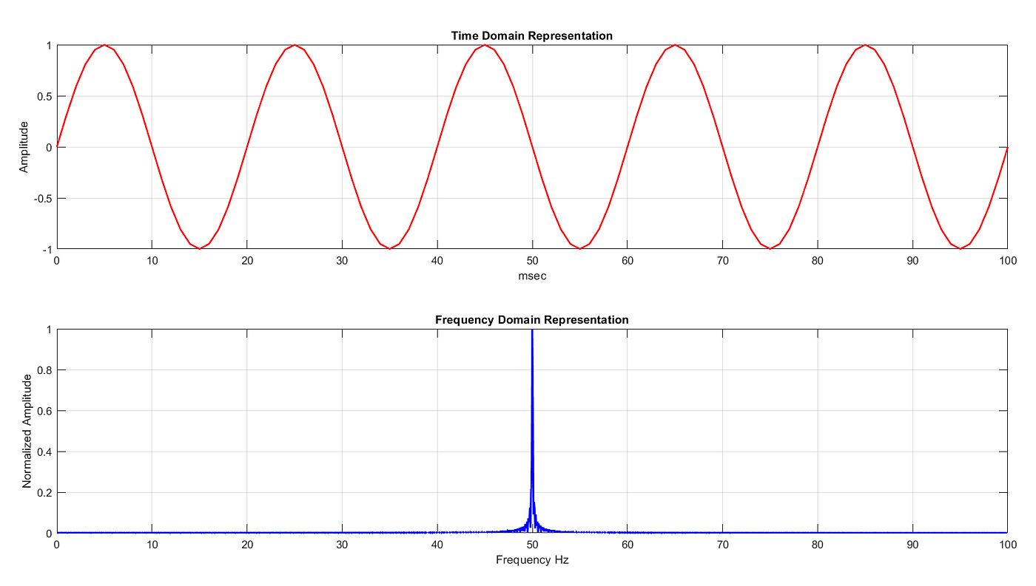
FFT in Action
Visual Example: This is an example of FFT processing a signal, transforming it from time to frequency domain.

Slide 11
FFT in Action [Contd.]
Step-by-Step Process: Let's consider a simple 4-point signal: [3, 1, 4, 1]. Using FFT:
Splitting: Divide into even-indexed [3, 4] and odd-indexed [1, 1] parts.
Applying DFT: Perform DFT on each: for [3, 4], it's [7, -1]; for [1, 1], it's [2, 0].
Combining: Combine these using FFT's butterfly operation to get the final frequency spectrum: [9, 1, 5, -1].
This process illustrates how FFT efficiently computes the frequency spectrum of a signal.
Real-time Processing: As an example of FFT's importance in real-time applications we can mention audio signal processing, where it enables quick analysis and transformation of live audio data for various effects and modifications.

Slide 12
Applications of FFT
Telecommunications: FFT is used in signal modulation and demodulation, crucial for data transmission in telecommunications systems.
Audio and Acoustic Engineering: In audio processing, FFT enables noise reduction, equalization, and analysis of audio signals for various applications.
Medical Imaging: FFT plays a pivotal role in reconstructing images from raw data in MRI and CT scans, enhancing medical diagnostic capabilities.

Slide 13
DFT vs. FFT: A Comparison
Performance Comparison: While DFT requires O(N2) computations for N data points, FFT dramatically reduces this to O(NlogN), making it significantly faster, especially for large datasets.
Application Suitability: DFT is simpler and suitable for small datasets or where computational resources are limited, while FFT is preferred for larger datasets due to its efficiency.
Practical Considerations: Choosing between DFT and FFT depends on factors like data size, computational speed requirements, and available processing power, with FFT generally favored for its speed in real-world applications.

Slide 14

Mathematical Deep Dive - DFT
Detailed Formula: The DFT formula, calculates each frequency component X[k] by summing over all points x[n] multiplied by a complex exponential factor.
Signal Decomposition: DFT decomposes a signal into a spectrum of frequencies, with each frequency represented by a complex number that indicates its amplitude and phase.
Phase and Amplitude: In the DFT output, the magnitude of each complex number X[k] represents the amplitude, and its angle (or phase) indicates the phase shift of the corresponding frequency component in the original signal.

Slide 15
Mathematical Deep Dive - FFT
FFT Algorithm Details: FFT algorithms, such as the Cooley-Tukey algorithm, efficiently compute the DFT by recursively breaking down the DFT calculation into smaller parts, reducing the overall number of computations.
Butterfly Operation: The 'butterfly' operation in FFT algorithms is a specific computational step that combines pairs of complex numbers in a way that contributes to the FFT's efficiency in computing the DFT.
Sample Decomposition: FFT divides the original sample set into smaller subsets (like even and odd indexed elements), processes them individually, and then combines the results to produce the final frequency domain representation.

Slide 16
Optimizations in FFT
Windowing Techniques: Windowing involves multiplying the signal by a window function before applying FFT, reducing spectral leakage and improving frequency resolution, especially at the boundaries of the signal.
Hardware Optimization: FFT algorithms are optimized for specific hardware platforms, like GPUs and FPGAs for parallel processing or DSPs for efficient real-time processing, to enhance performance and speed.
Parallel Computing: Leveraging parallel computing in FFT allows simultaneous processing of multiple data points, significantly accelerating the computation, especially for large and complex datasets.

Slide 17
Challenges in Implementation
Computational Resources: Implementing FFT requires balancing computational resources, as more complex signals demand more processing power and memory, posing challenges in constrained environments.
Accuracy and Precision: Accuracy in FFT computations can be affected by factors like numerical precision and rounding errors, especially in fixed-point arithmetic used in some hardware.
Algorithm Selection: Choosing the right FFT algorithm (like Radix-2 or split-radix) depends on factors like data size and hardware capabilities, requiring careful consideration for optimal performance.

Slide 18
Case Study
In a key application, FFT was used to analyze seismic data for earthquake prediction. It transformed time-based seismic waveforms into frequency domain, revealing distinct patterns crucial for identifying seismic activity. This enabled quicker, more accurate earthquake predictions by efficiently processing large data sets in real-time.
Data Analysis: seismic data was converted from time to frequency domain using FFT, revealing patterns and frequencies crucial for understanding seismic activities.
Impact and Outcomes: FFT enabled faster and more accurate analysis, leading to better earthquake prediction and preparedness strategies.

Slide 19
The Future of Fourier Transforms
Emerging Trends: We can explore recent advancements in Fourier transforms, including novel algorithms and techniques that enhance their capabilities for various applications.
Integration with AI and ML: Nowadays Fourier transforms play a crucial role in feature extraction and data analysis, enabling advanced applications in data science and automation.
Potential Future Applications: There are tons of potential future applications of Fourier transforms, such as their use in cutting-edge technologies, scientific discoveries, and innovations across diverse fields, ranging from healthcare to telecommunications.

Slide 20
Conclusion
Summary:
Introduction to Fourier Transforms: We began by introducing Fourier Transforms as a mathematical technique to analyze signals by decomposing them into their constituent frequencies.
DFT vs. FFT: We compared the Discrete Fourier Transform (DFT) and the Fast Fourier Transform (FFT), highlighting how FFT's efficient algorithm reduces computational complexity from O(N*2) to O(NlogN).
Mathematical Deep Dive: We explored the mathematical details of both DFT and FFT, explaining their formulas and how they represent frequency components.
Applications and Impact: We discussed real-world applications of FFT in telecommunications, audio processing, and medical imaging, emphasizing its role in signal analysis and data processing.
Future Trends: We speculated on the future of Fourier Transforms, including emerging trends, integration with AI and ML, and potential applications across various fields, showcasing their continued relevance in advancing technology and science.

Slide 21
Conclusion
Final Thoughts:
Pivotal Analysis Tools: DFT and FFT serve as pivotal tools for signal analysis and processing, enabling advancements in fields like telecommunications, medical imaging, and data science by efficiently extracting valuable information from complex datasets.
Real-Time Processing: These algorithms empower real-time processing of vast amounts of data, making them indispensable in applications where speed and accuracy are critical, such as live audio processing and seismic data analysis.
Future Innovation: As FFT continues to integrate with artificial intelligence and machine learning, and with ongoing research into emerging trends, the algorithms promise to play an even more influential role in shaping the future of technology and scientific discoveries.

Slide 22
THE END

